Slide 1
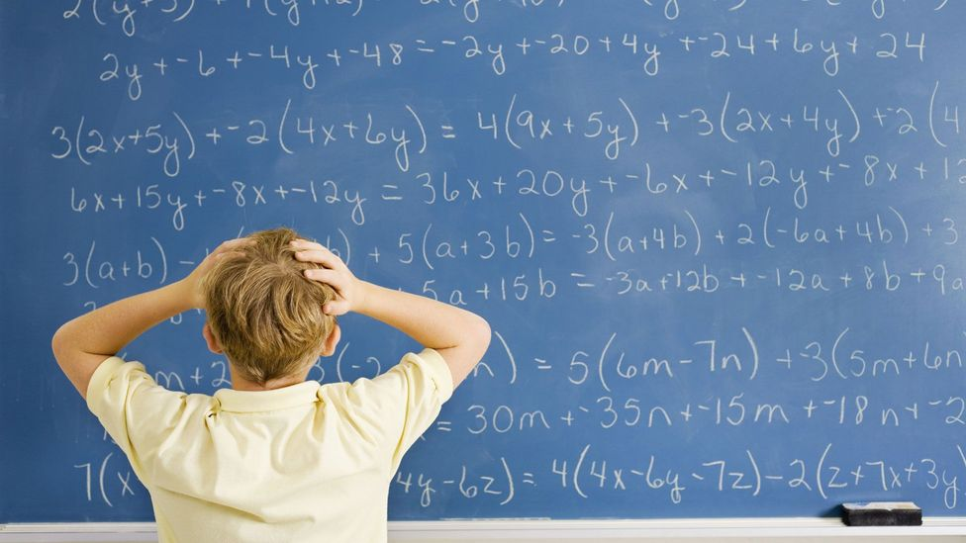
Dyscalculia
Dyscalculia can make learning maths at primary school particularly difficult. However, both teachers and parents can support children through various strategies when covering areas such as times tables, number facts, telling time and word problems.

Slide 2
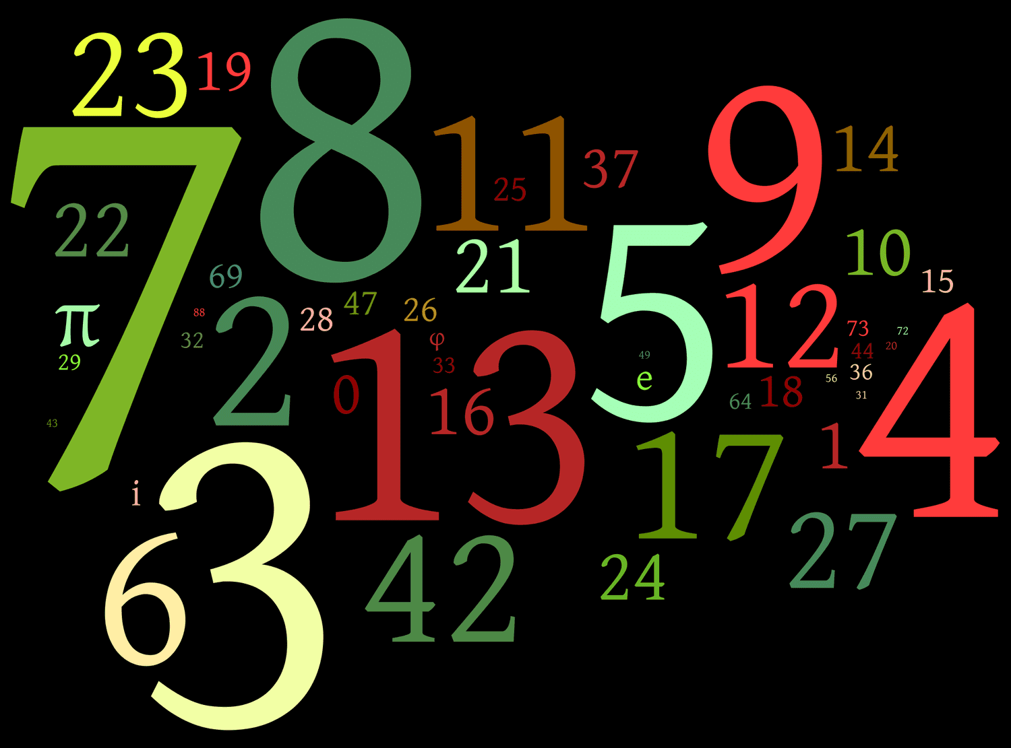
What is dyscalculia?
Dyscalculia is a specific learning difficulty in mathematics that affects around 5% of the population.
It is better thought of as difficulty with arithmetic skills and numeracy, rather than in mathematics learning as a whole, as there may be no difficulty with topics such as shape or geometry.
Put simply, dyscalculic people have no clear understanding of quantity. They lack number sense, which means that they have a hard time comprehending our number system and how numbers relate to each other.

Slide 3
Indicators of dyscalculia?
The indicators, manifestations or symptoms of dyscalculia can be thought of in terms of four different areas of learning:
Core number
Reasoning
Memory
Visual spatial
Notes:
Can you guess the 4 indicators of dyscalculia? Visual spacing can be even their own body space, or visualising things in space, its used for basic processing skills like tying laces

Slide 4
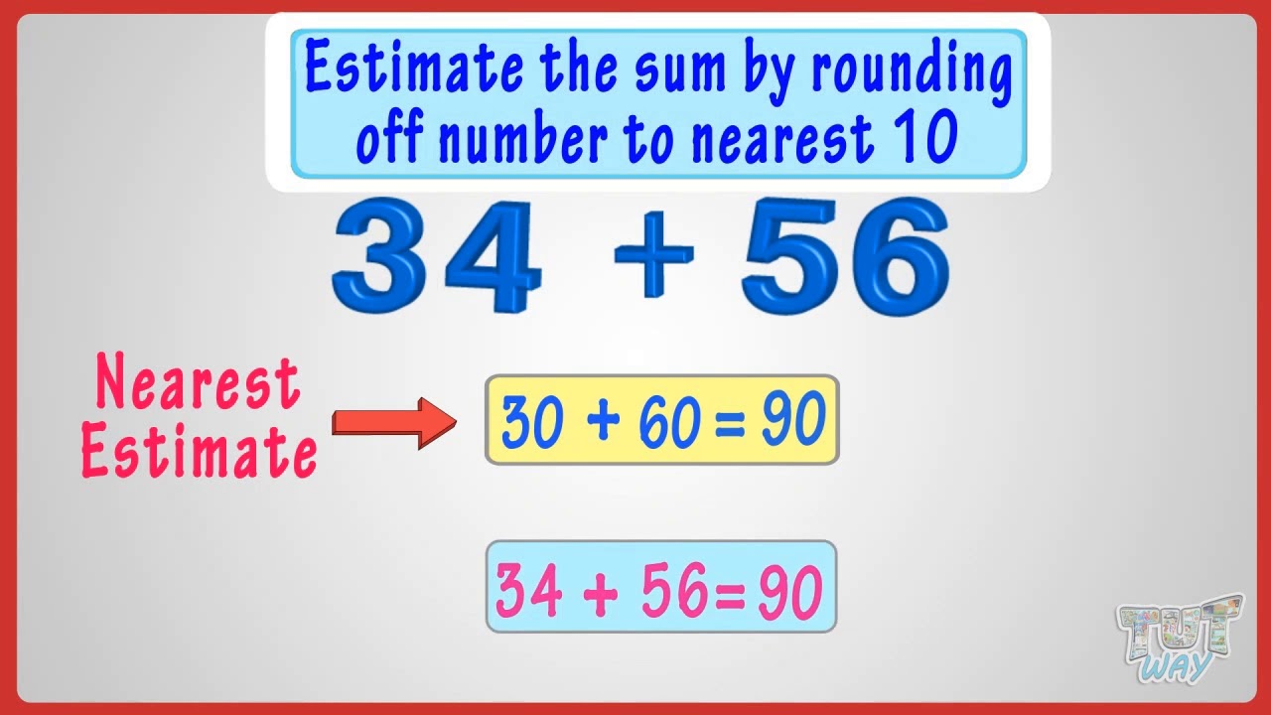
Core Number
This particular sub type of
dyscalculia will lead to
difficulties with:
Basic number sense
Estimating and rounding
Appreciating numerical quantity
Working with mathematical symbols
Place value
Placing numbers on a number line
Notes:
So all the basics of number from reception onwards. Talk about how reception-2 are doing basic mastering of number with visuals and concrete objects so that they can recognise numbers and manipulation of numbers quickly.

Slide 5
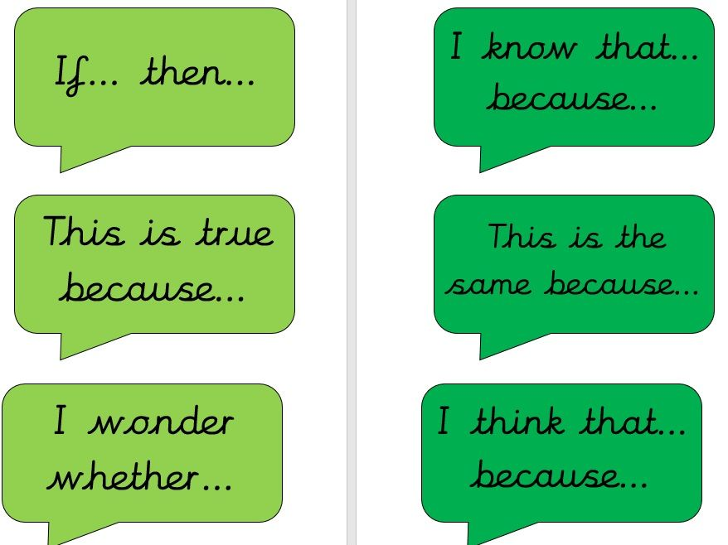
Reasoning
This particular sub type of dyscalculia will lead to difficulties with:
Understanding mathematical concepts and relationships
Generalising and transferring information
Understanding multiple steps in complex procedures/algorithms
Problem-solving and decision making
Notes:
So all the basics of number from reception onwards. Talk about how reception-2 are doing basic mastering of number with visuals and concrete objects.

Slide 6

Memory
This particular sub type of dyscalculia will lead to difficulties with:
Remembering and recalling numerical facts
Understanding and recalling mathematical terminology
Understanding word problems
Performing mental calculations accurately
Keeping track of the steps in problem-solving
Notes:
So all the basics of number from reception onwards. Talk about how reception-2 are doing basic mastering of number with visuals and concrete objects.

Slide 7
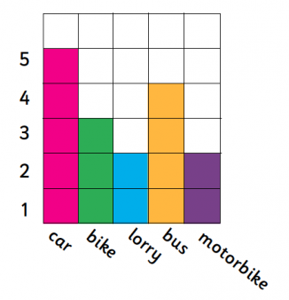
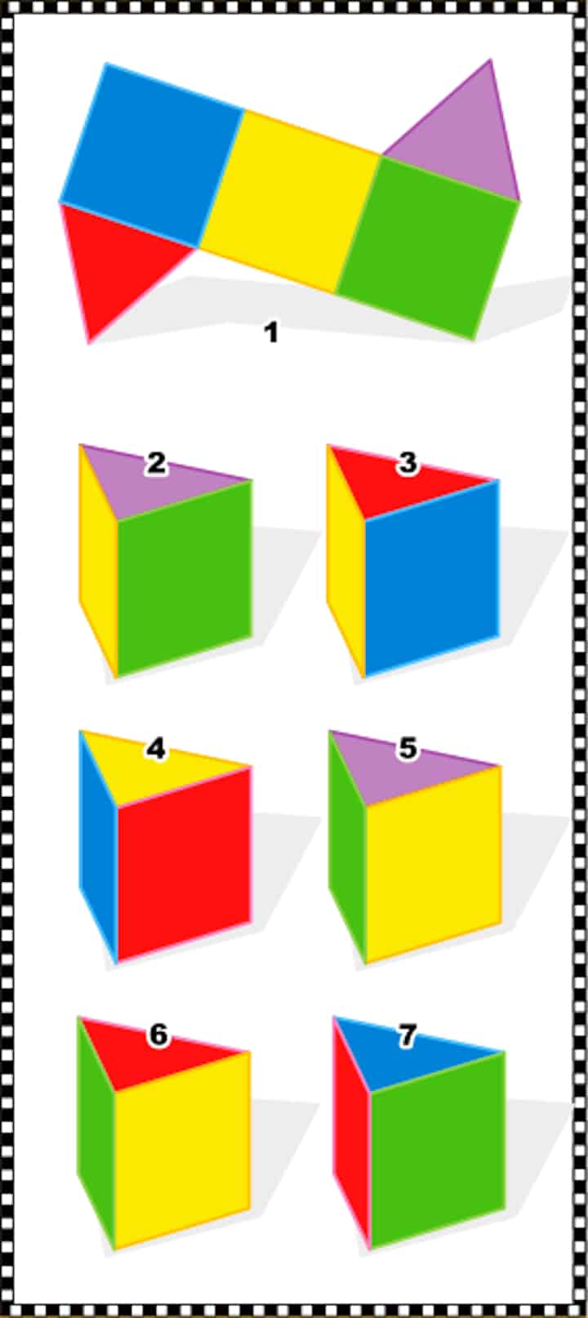
Visual Spatial
This particular sub type of dyscalculia will lead to difficulties with:
Recognising and understanding symbols
Interpreting visual representations of mathematical objects
Interpreting graphs and tables
Notes:
So all the basics of number from reception onwards. Talk about how reception-2 are doing basic mastering of number with visuals and concrete objects.

Slide 8
Does dyscalculia correlate to other learning difficulties?
Dyscalculia rarely occurs in isolation and often co-occurs with other learning difficulties such as dyslexia, dyspraxia, dysgraphia, ADHD and auditory processing
Notes:
So all the basics of number from reception onwards. Talk about how reception-2 are doing basic mastering of number with visuals and concrete objects.

Slide 9
Strategies to help with dyscalculia
Use concrete materials, such as Cuisenaire rods, ten frames, dienes, two coloured counters and base ten materials.
Spend time exploring these and don’t take them away too soon; they will help to develop the child’s understanding.
Play games with dice and dominoes so that the child can recognise common dot patterns; this will help with subitising and seeing the relationship between one number and another.
Try to encourage the child to use more efficient calculating strategies, such as counting on rather than counting all.
Notes:
Make sure any interventions that are had the children have concrete objects to manipulate

Slide 10
Strategies to help with dyscalculia
Encourage the child to visualise the maths by drawing diagrams and using concrete materials to model the maths.
Make sure the maths practical is as multisensory as possible; try to avoid worksheets.
Adopt a little and often approach; repetition and ‘overlearning’ will help.
Use mathematical language as much as possible and encourage the child to do the same.
Give multiplication tables and number bonds to reduce the stress of having to remember these facts.
Notes:
Make sure any interventions that are had the children have concrete objects to manipulate

