Slide 1
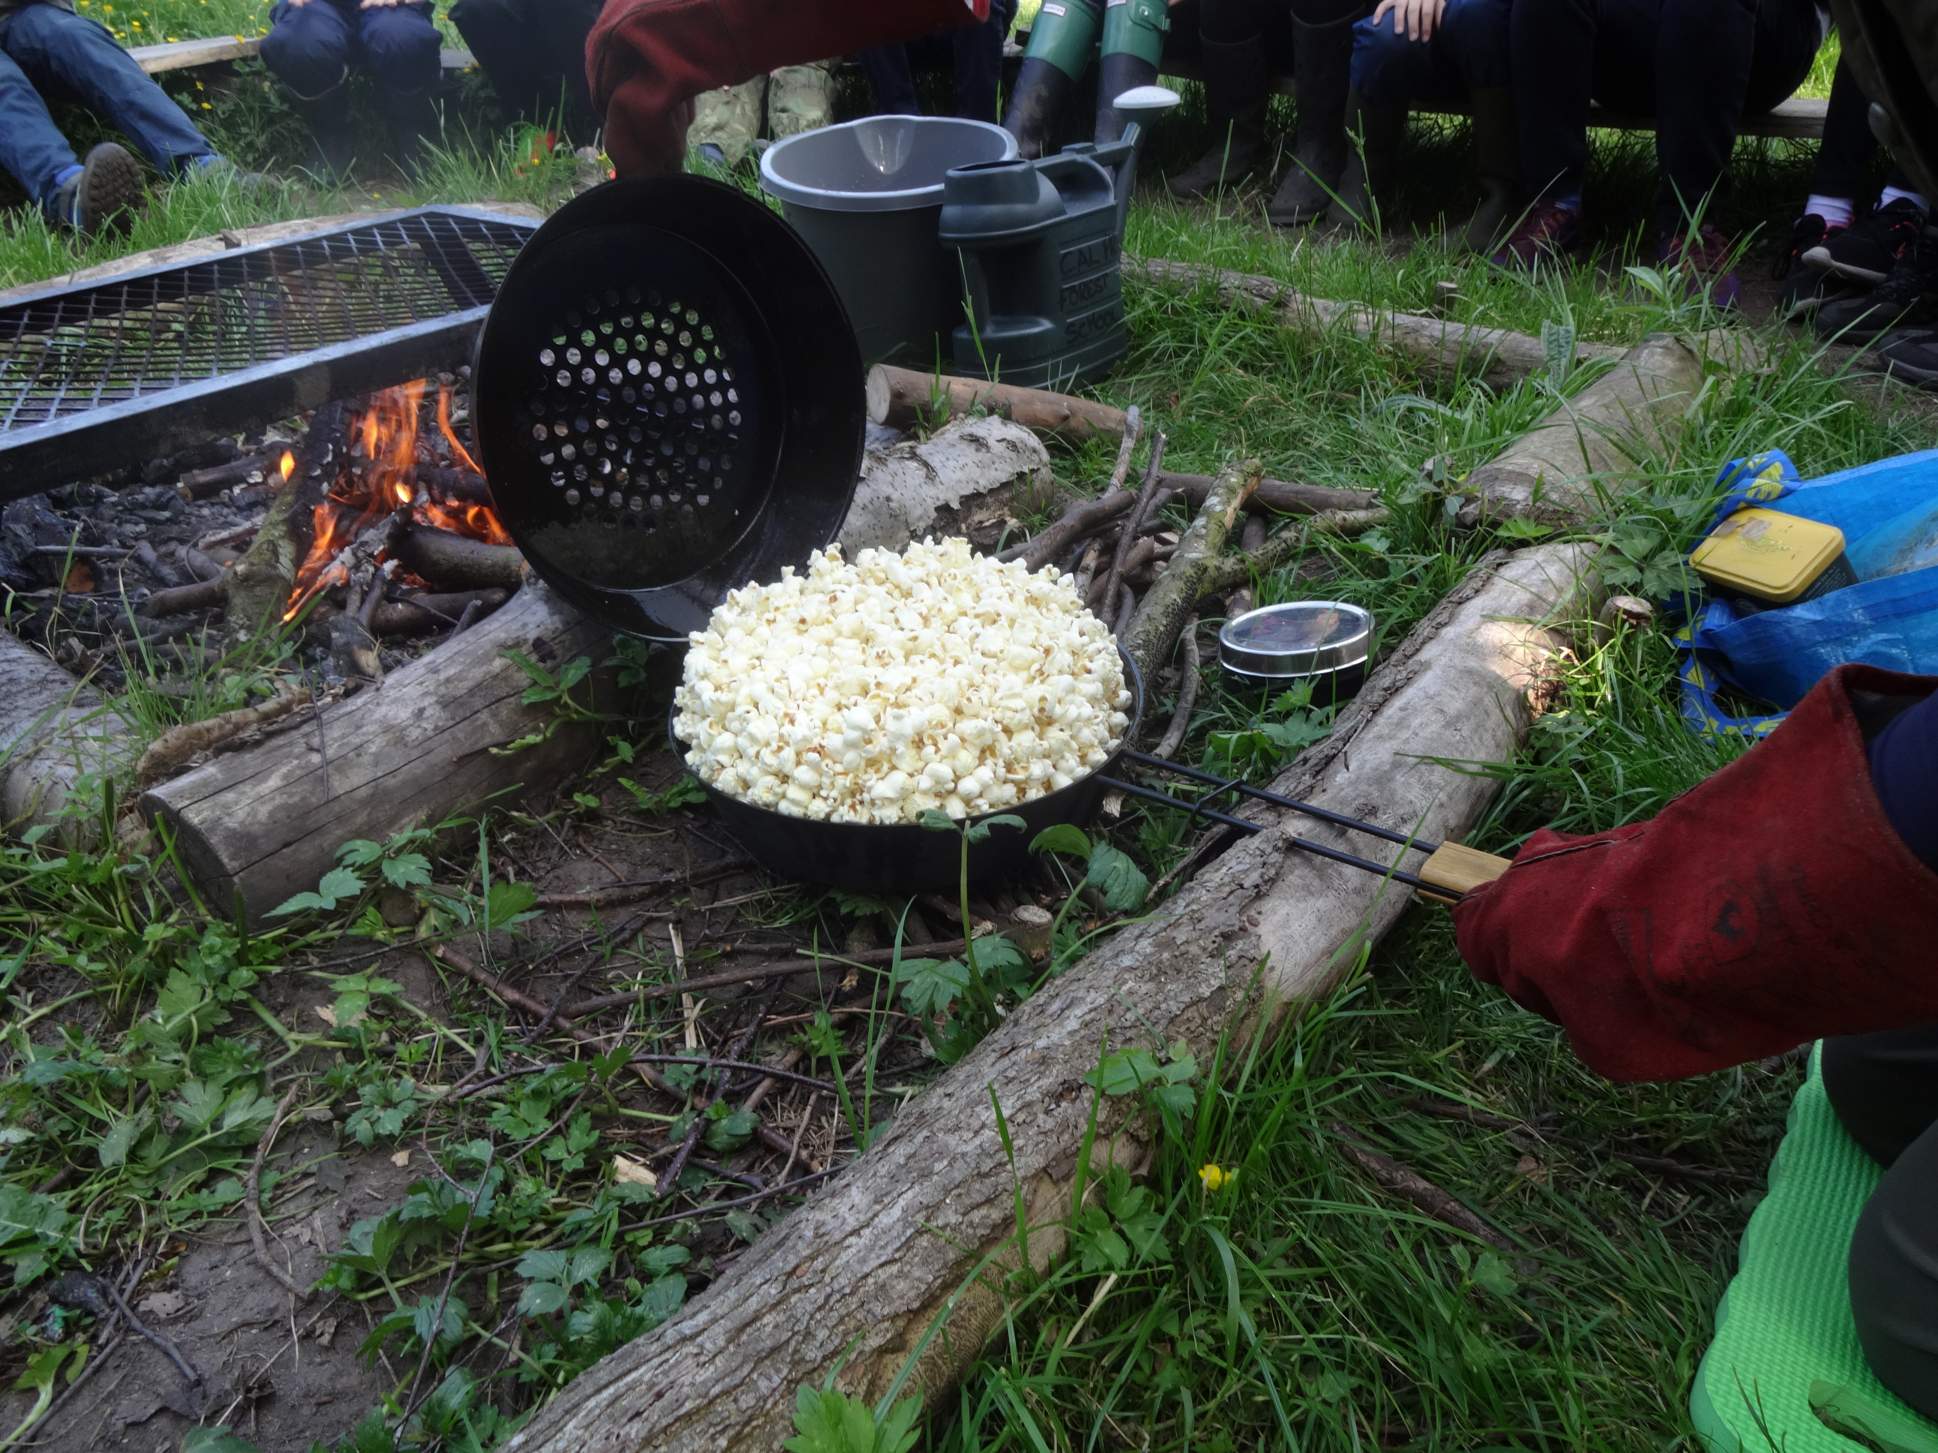
Forest school
R Davis

Slide 2
The philosophy of Forest Schools is to encourage and inspire individuals of any age through positive outdoor experiences.
By participating in engaging, motivating and achievable tasks and activities in a woodland environment each participant has an opportunity to develop intrinsic motivation, sound emotional and social skills. These, through self awareness can be developed to reach personal potential.

Slide 3
At Forest School all participants are viewed as:
•equal, unique and valuable
•competent to explore & discover
•entitled to experience appropriate risk and challenge
•entitled to choose, and to initiate and drive their own learning and development
•entitled to experience regular success
•entitled to develop positive relationships with themselves and other people
•entitled to develop a strong, positive relationship with their natural world

Slide 4
The children's views…
What do you like?
making dens
popcorn and hot chocolate
roasting marshmallows
climbing
the digging area
What would you change?
more time
bigger boundary
more fires
NOTHING!
What have you learnt?
nature is important
tie knots
rope swings and ladder
to work together
how to use flint and steel
Year 3

Slide 5
What do you like?
making tree cookies
marshmallows and hot chocolate
making dens, ladders and swings
dig hole
climbing trees
it’s fun! (…gallons of fun)
we liked working as a team and no-one was left out
makes me feel ‘like an explorer’
What would you change?
more time and space
have a tree house
have lunch there
nothing…it was amazing
What have you learnt?
knowing what tools to use for different widths of wood
using tarpaulin
how to keep safe around sticks, stones and tools
to make tents as a team
how to make fire
to tie knots
to care about nature
Year 4

Slide 6
What do you like?
making shelters and playing with friends
smores and popcorn over the fire
relaxing in the hammock
looking for bugs
‘I loved every second of it’
its an ‘escape from the business of lessons’
I loved the teamwork that our class built
the freedom, being adventurous
that you can run free…I appreciate everyone who paid for it
What would you change?
extend the area
how long we had ‘before we heard the dreaded 1,2,3 Oldswinford…’
a variety of biscuits!
‘I wouldn’t change anything, it’s SO GOOD!!!!!!!’
What have you learnt?
to make bows and arrows with Cal
how to work as a team
about keeping safe in forests
never to walk in the fire ring Year 5

Slide 7
What do you like?
everything
making dream catchers
using binoculars and magnifying glasses
all the creative things you can do
meeting Cal and the forest school crew
climbing trees
running around and exploring
being able to do risky things
being outdoors away from the stuffy classroom
What would you change?
nothing
make a zip wire
bigger area
more time
What have you learnt?
how to whittle
how to tie ‘a clothes hitch’
‘what a y stick is used for’
square lashing
that you can have a lot of fun outdoors
you can do things you didn’t know you can do Year 6

Slide 8
Teacher opinions…
children inspired and had chance to share their knowledge
some children were brought out of their shell and it peaked their curiosity in the world around them
half class teaching allowed more 1-2-1 time and riskier activities with smaller groups
children’s enjoyment of Forest school was clear to see
‘social interaction’ time is needed under adult supervision to help them with their relationships

